Slide 1
Crowd counting and heatmap
By Jun Ming – cs 397 Deep learning

Slide 2
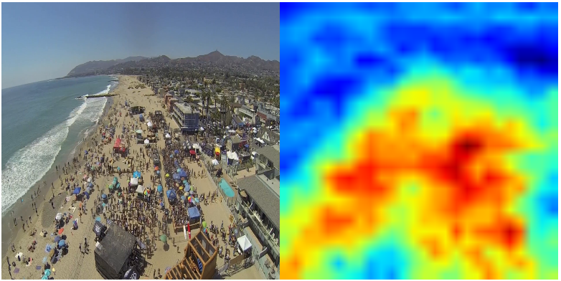
objective
To generate a heatmap or density map of an image depicting a crowd
Perform crowd counting
Let us know if the density of the crowd is too closely packed

Slide 3
Real world application
Generating Heatmaps are one of the most useful application used to determine crowd size and denseness.
In the current COVID-19 situation, we want to be able determine if an image is dense. By identifying whether it is dense and looking at the heatmap, we are able to see where are the places that require attention or additional monitoring.

Slide 4
Real world application
Other real-world application
Human crowd detection using drone
Crowd movement to determine product popularity
In a convention / festival

Slide 5
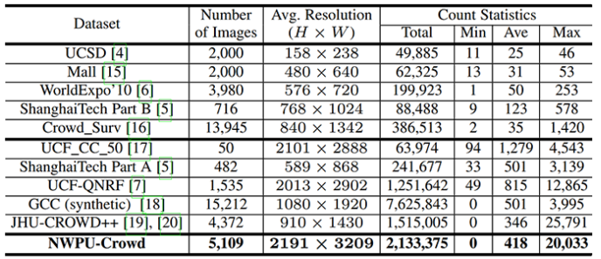
Dataset used
Dataset: NWPU
https://gjy3035.github.io/NWPU-Crowd-Sample-Code/
Consist of 3609 images with annotated instances

Slide 6
Dataset used
The advantage of this dataset is:
Combines multiple dataset
Negative Samples
Large Variation
High Resolution
However, as a CNN network can only takes in a single resolution, the images will be resized within python to be 256 by 256. May change to 500 by 500.

Slide 7
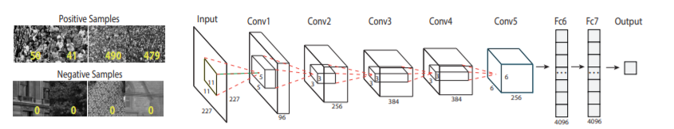
Proposed architectures
Due to the complexness of the project and the scope, I will attempt to implement various models that have been proposed by various experts.
https://yangliang.github.io/pdf/sp055u.pdf
It is a CNN regression model where the base of the neural network is the Alexnet to estimate the count

Slide 8
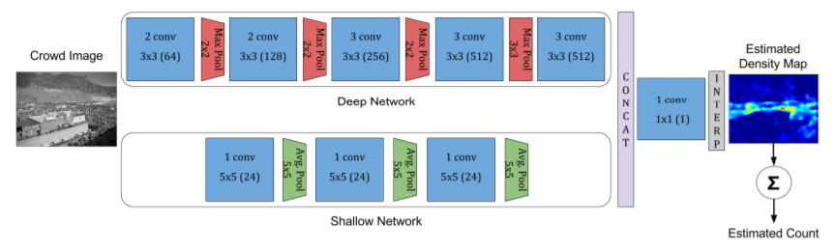
Proposed architectures
https://arxiv.org/pdf/1608.06197.pdf
This method makes use of both a deep and shallow network to generate a heatmap or density map
Downside: Image is 1/32 the original resolution due to the max-pooling

Slide 9
Plan for next week
Current problem:
Tried implementing the CNN-Alexnet regression model but CPU and GPU cannot handle the size of the neural network
Have to use the school computer to train the neural network which cannot be used at the moment
Hopefully, I will be able to finish training the first proposed CNN architecture model

Slide 10
Thank you!!!

